Slide 1
Data Analyst Internship Task-2 Topic - Corona Virus Analysis
DONE BY - ARYAN BHORASKAR

Slide 2
PROBLEM STATEMENT
Applying analytical skills and SQL Queries to derive meaningful insights from a dataset with 78,387 records.
Being able to use SQL to derive meaningful and tangible results from such a massive datasets showcases te strengths of SQL and highlights the need to be able to write efficient SQL Queries as a key skill for any data analyst.
This particular problem statement requires the need to generate data-driven insights to understand the spread of th Corona Virus Pandemic, which had a massive impact on public health worldwide.

Slide 3
Dataset Description
The Dataset contains the following columns:
Province: Geographic subdivision within a country/region.
Country/Region: Geographic entity where data is recorded.
Latitude: North-south position on Earth's surface.
Longitude: East-west position on Earth's surface.
Date: Recorded date of CORONA VIRUS data.
Confirmed: Number of diagnosed CORONA VIRUS cases.
Deaths: Number of CORONA VIRUS related deaths.
Recovered: Number of recovered CORONA VIRUS cases.

Slide 4
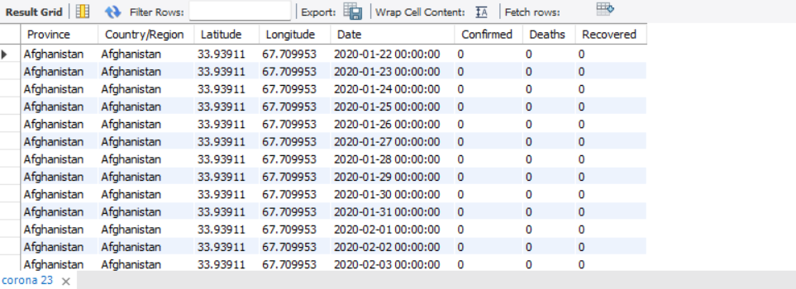
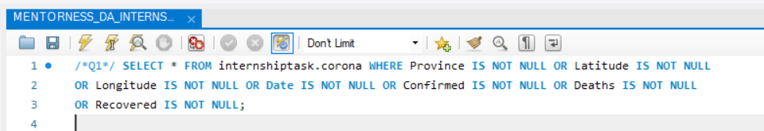
DATA PRE-PROCESSING
First, we write the query to check whether we have any null values, as they can lead to errors if left unattended.

Slide 5
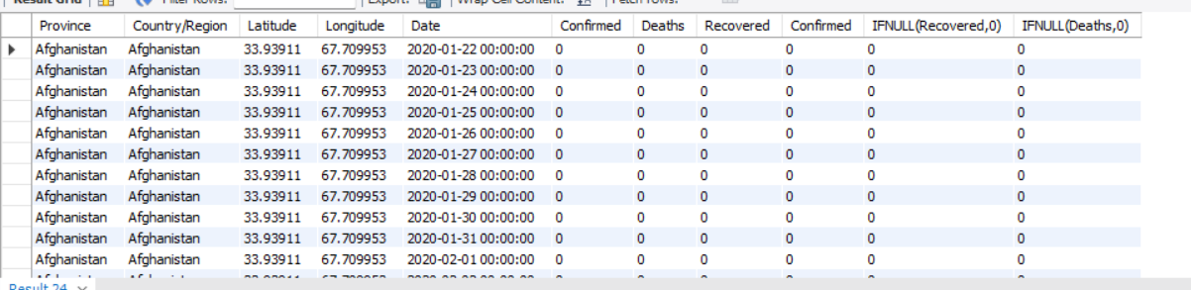
DATA PRE-PROCESSING
IF NULL VALUES ARE PRESENT,
REPLACE THEM WITH A ZERO.

Slide 6

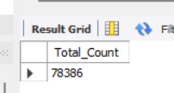
DATA IN-SIGHTS
We can check the total number of rows to find out the size of the dataset we are dealing with.

Slide 7
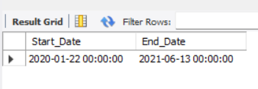

DATA IN-SIGHTS
We can run a query to figure out the start and end date of the dataset.

Slide 8
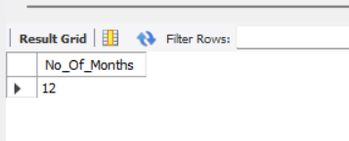
DATA IN-SIGHTS
We can also figure out the number of months present in our dataset.

Slide 9
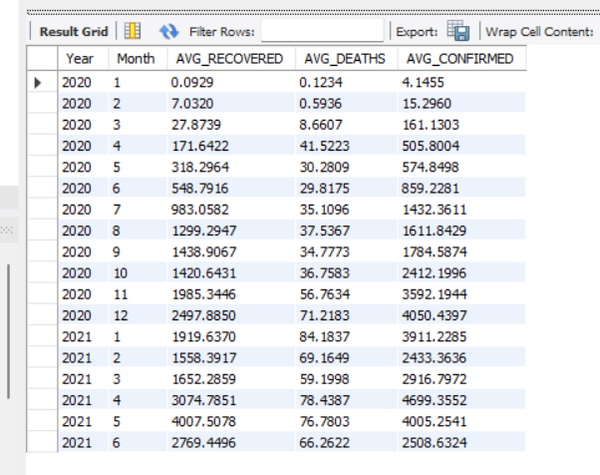
DATA IN-SIGHTS
Finding monthly averages for number of confirmed, recovered and death related cases, is a valuable insight!

Slide 10
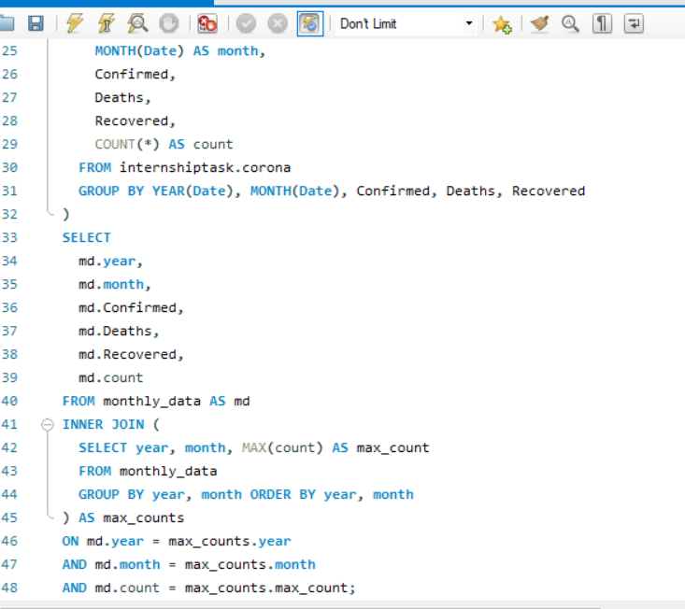
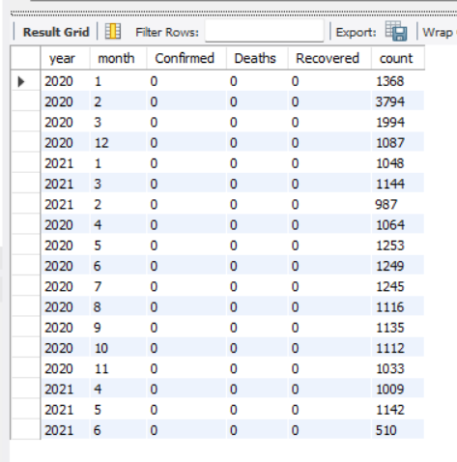
DATA IN-SIGHTS
Finding the most frequent value for number of confirmed, recovered, and death cases.

Slide 11
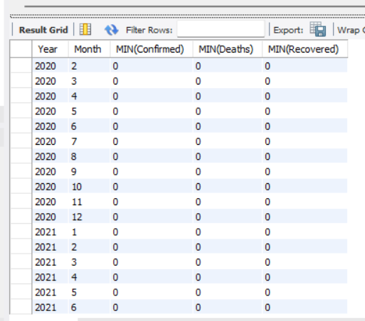
DATA IN-SIGHTS
Finding Minimum number of confirmed, recovered and deaths per year per month.

Slide 12
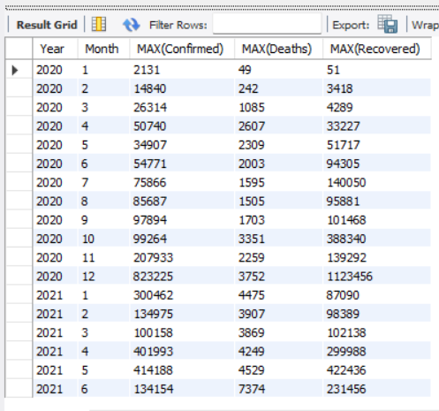
DATA IN-SIGHTS
Finding the maximum number of confirmed, recovered and deaths.

Slide 13
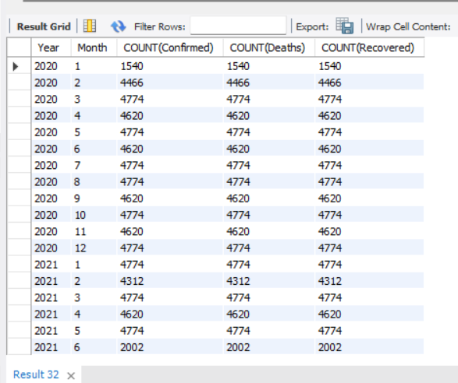
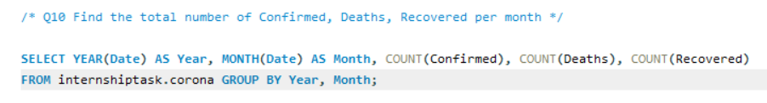
DATA IN-SIGHTS
Finding the total number of confirmed, recovered and deaths.

Slide 14
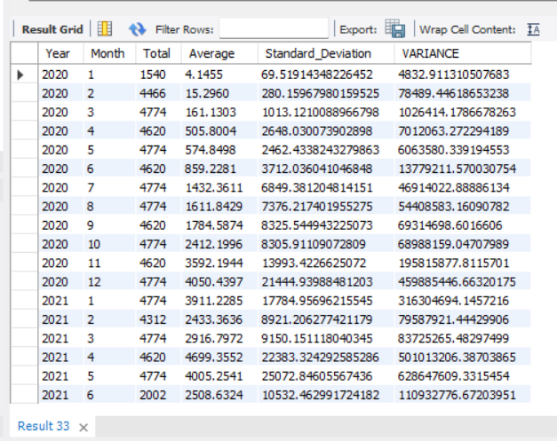
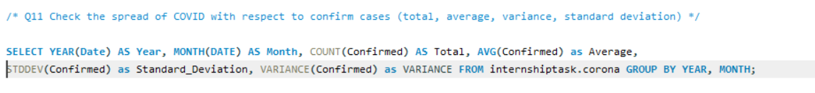
DATA IN-SIGHTS
Checking the spread of COVID with respect to the number of confirmed cases.

Slide 15
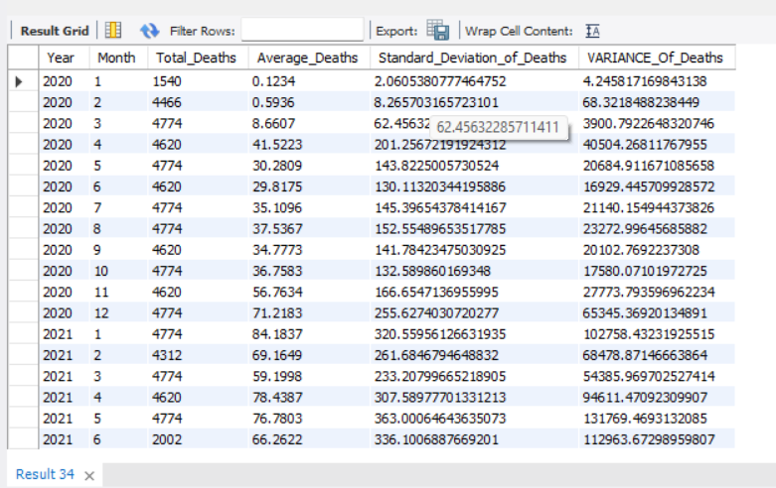
DATA IN-SIGHTS
Checking the spread of COVID with respect to the number of deaths caused.

Slide 16
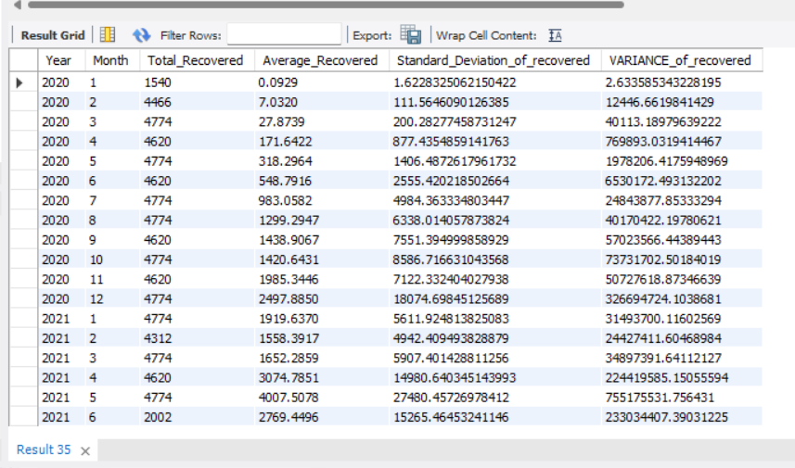
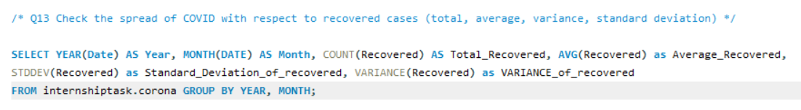
DATA IN-SIGHTS
Checking the spread of Covid with respect to the number of recovered cases.

Slide 17
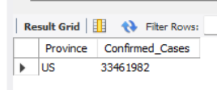
DATA IN-SIGHTS
Finding the Country with the highest number of confirmed cases.
ANSWER - The United States with a confirmed case count of 3,34,61,982

Slide 18
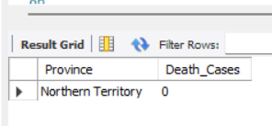
DATA IN-SIGHTS
Finding the Country with the lowest count of deaths related to COVID.
Answer - The Northern Teritory Province of Australia with a death count of zero

Slide 19
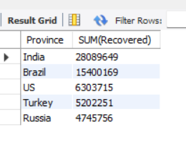
DATA IN-SIGHTS
Answer - The top 5 countries in terms of highest recovery cases are :
INDIA
BRAZIL
US
TURKEY
RUSSIA
Finding the Top 5 countries with the highest recovered cases.

Slide 20
INSIGHTS & ANALYSIS
After analysing the average number of confirmed, recovered and death cases, a noticeable decrease can be picked up on when comparing the data of 2020 with that of 2021, which indicates that people started vaccinating themselves, taking part in social distancing and following all appropriate safety protocols.
The United States had the most number of confirmed COVID cases of all the different countries across the 18 month period of 22nd January, 2020 to 13th June, 2021, which indicates that many people did not take the pandemic and its devastating effects very seriously.

Slide 21
INSIGHTS & ANALYSIS
The Province with the least number of deaths was the Northern Territory of Australia with an impressive death count of Zero0.
The Top 5 countries with the most recovery cases are :
India with a total recovery cases of 2,80,89,649.
Brazil with a total recovery case of 1,54,00,169.
US with a total recovery case of 63,03,715.
Turkey with a total recovery case of 52,02,251.
Russia with a total recovery case of 47,45,756.

Slide 22
THANK YOU

